Slide 1


Financial Metrics Analysis: Measuring Business Success
Financial metrics analysis is essential for understanding a business's performance. It's vital for strategic decision-making and long-term growth.
by Ashok Shetti

Slide 2

Introduction
Financial metrics are quantifiable measures that reflect a business's performance. They provide insights into financial health, profitability, and overall success.
1
Financial Health
2
Profitability
Metrics like profitability, liquidity, and solvency indicate the business's overall stability and ability to meet its obligations.
Metrics such as gross profit margin, operating profit margin, and net profit margin measure how well a business generates profits.
3
Efficiency
4
Growth
Metrics like inventory turnover, accounts receivable turnover, and asset turnover indicate the business's ability to manage resources effectively.
Metrics like revenue growth, market share growth, and employee growth indicate the business's expansion and development.

Slide 3
Reason to Choose the Project
Financial metrics analysis provides valuable insights that can help businesses make informed decisions. It allows them to identify strengths, weaknesses, and areas for improvement.
Strategic Decision Making
Performance Benchmarking
Investor Confidence
By understanding key metrics, businesses can make data-driven decisions regarding investments, pricing strategies, and resource allocation.
Comparing financial metrics to industry standards and competitors allows businesses to assess their relative position and identify areas for improvement.
Strong financial metrics demonstrate the business's viability and potential for growth, attracting investors and securing funding for expansion.

Slide 4

Problem Statement
The problem statement identifies the specific challenge or opportunity that financial metrics analysis aims to address. It sets the context for the analysis and guides the process.
Declining Profitability
Slow Growth
A business may experience declining profits due to factors such as increased competition, rising costs, or changes in customer demand.
A business may struggle to achieve desired growth rates due to insufficient market penetration, ineffective marketing strategies, or operational inefficiencies.
Financial Risk
A business may face financial risk due to excessive debt levels, inadequate cash flow, or exposure to economic volatility.

Slide 5

Key Financial Metrics
Key financial metrics provide a comprehensive view of a business's performance and can be categorized into different areas.
Category
Metric
Description
Profitability
Gross Profit Margin
Measures the profitability of the core business activities, reflecting the efficiency of production and cost control.
Liquidity
Current Ratio
Measures the ability of a business to meet its short-term financial obligations using readily available assets.
Solvency
Debt-to-Equity Ratio
Measures the proportion of a business's financing that comes from debt compared to equity, indicating the financial risk associated with debt.
Efficiency
Inventory Turnover Ratio
Measures how efficiently a business manages its inventory, reflecting the speed at which inventory is sold and replenished.

Slide 6



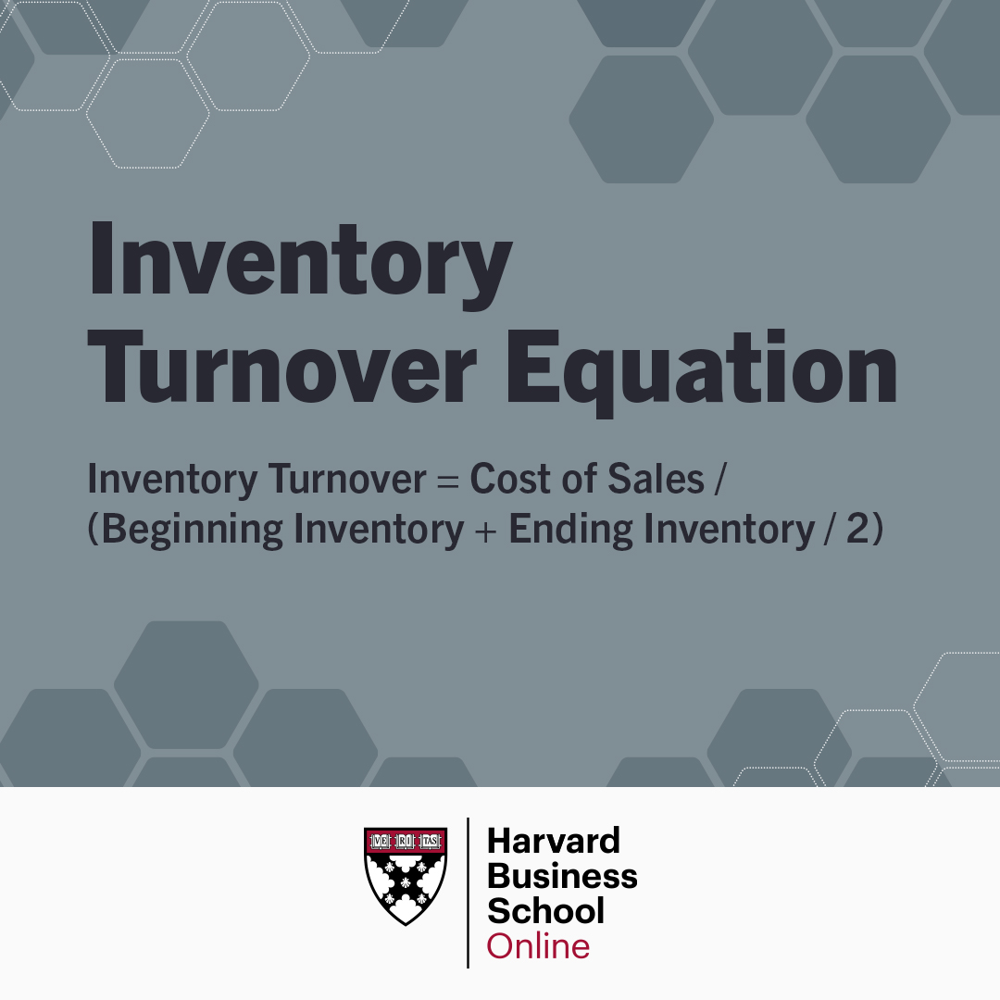

Slide 7
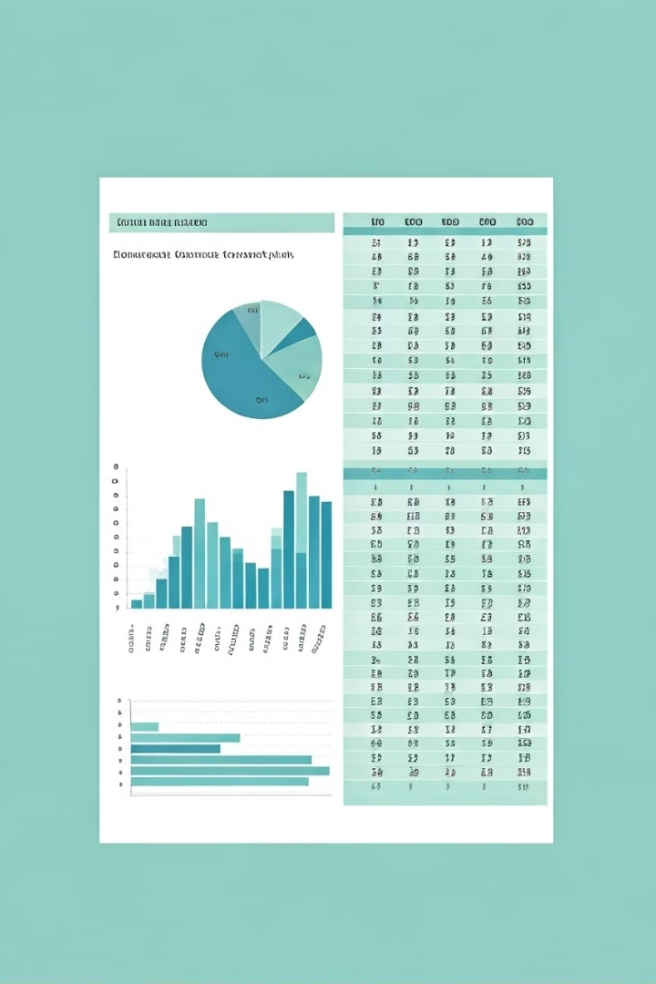
Financial Model
A financial model is a representation of a business's financial performance and future projections. It's used to forecast key metrics and evaluate different scenarios.
1
Assumptions
The financial model starts with assumptions about key variables, such as revenue growth, cost of goods sold, and operating expenses.
2
Financial Statements
The model then projects financial statements, including the income statement, balance sheet, and statement of cash flows.
3
Key Metrics
The model calculates key financial metrics based on the projected financial statements, allowing for analysis and scenario planning.
4
Sensitivity Analysis
Sensitivity analysis explores the impact of changes in key assumptions on the projected financial metrics, helping to assess risk and evaluate different strategies.

Slide 8





Flow Chart
A flowchart visually represents the steps involved in a financial metrics analysis process, providing a clear understanding of the workflow.
Data Collection
The first step is to gather relevant financial data from various sources, including financial statements, market research, and industry reports.
Data Cleaning & Preparation
The collected data is cleaned and prepared for analysis, ensuring consistency, accuracy, and relevance for the analysis.
Metric Calculation
Key financial metrics are calculated using appropriate formulas based on the prepared data, providing quantitative measures of performance.
Analysis & Interpretation
The calculated metrics are analyzed and interpreted in relation to historical trends, industry benchmarks, and business objectives.
Reporting & Communication
The results of the analysis are presented in a clear and concise manner, using charts, graphs, and narratives to communicate insights.

Slide 9
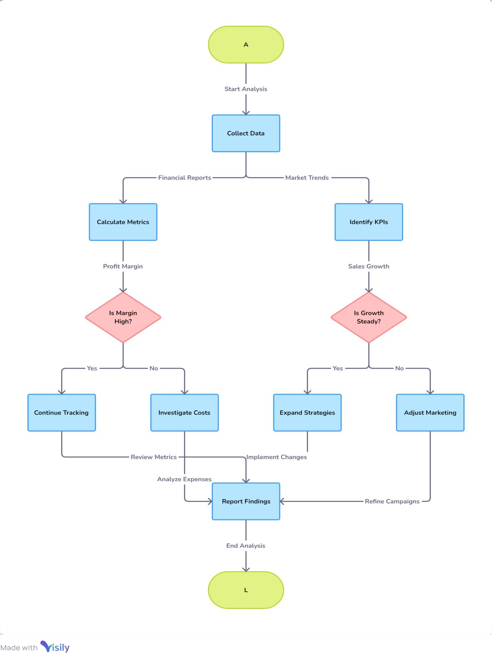

Slide 10
DAX(Data Analysis Expressions )QUERIES :
Profit margin = DIVIDE([Profit],[Sales Amount])
Profit = SUM(financials[Profit])
Sales Amount = SUM(financials[Gross Sales])
Profit margin = DIVIDE([Profit],[Sales Amount])
Discount offered = SUM(financials[Discounts])
Total Revenue = SUM(financials[Profit])

Slide 11




Advantages and Disadvantages
Financial metrics analysis offers numerous benefits, but it's important to consider potential limitations and challenges.
Improved Decision Making
Enhanced Performance
Reduced Financial Risk
Time-Consuming
Collecting, cleaning, and analyzing data can be time-consuming, requiring dedicated resources and expertise.
Provides data-driven insights for informed strategic decisions, leading to better resource allocation and risk management.
Helps identify areas for improvement and drives growth by highlighting strengths and weaknesses.
Provides a clear picture of financial health, enabling proactive risk management and mitigation strategies.

Slide 12





Future Scope
Financial metrics analysis is constantly evolving with advancements in technology and the emergence of new business models.
Automated Analysis
Advanced Analytics
The use of artificial intelligence and machine learning will further automate financial analysis, enabling faster and more accurate insights.
Sophisticated analytical techniques will provide deeper insights into complex business relationships and uncover hidden patterns.
Data-Driven Insights
Cloud-Based Platforms
The increased availability of data and the ability to analyze it will enable businesses to make more informed decisions.
Cloud-based platforms will provide flexible and scalable solutions for financial analysis, enabling access to powerful tools and real-time data.

Slide 13

Conclusion
Financial metrics analysis is an indispensable tool for businesses seeking to achieve sustainable growth and success. It provides a structured and data-driven approach to understand performance, identify opportunities, and mitigate risks.

